Slide 1
Artificial intelligence systems. Introduction
Lecture 1

Slide 2
Basic Concept of Artificial Intelligence (AI)
Artificial Intelligence is a way of making a computer, a computer-controlled robot, or a software think intelligently, in the similar manner the intelligent humans think. AI is accomplished by studying how human brain thinks and how humans learn, decide, and work while trying to solve a problem, and then using the outcomes of this study as a basis of developing intelligent software and systems.
The development of AI started with the intention of creating similar intelligence in machines that we find and regard high in humans.

Slide 3
The Necessity of Learning AI
AI can learn through data
In our daily life, we deal with huge amount of data and human brain cannot keep track of so much data. That is why we need to automate the things. For doing automation, we need to study AI because it can learn from data and can do the repetitive tasks with accuracy and without tiredness.
AI can teach itself
It is very necessary that a system should teach itself because the data itself keeps changing and the knowledge which is derived from such data must be updated constantly. We can use AI to fulfill this purpose because an AI enabled system can teach itself.
AI can respond in real time
Artificial intelligence with the help of neural networks can analyze the data more deeply. Due to this capability, AI can think and respond to the situations which are based on the conditions in real time

Slide 4
The Necessity of Learning AI -2
AI achieves accuracy
With the help of deep neural networks, AI can achieve tremendous accuracy. AI helps in the field of medicine to diagnose diseases such as cancer from the MRIs of patients.
AI can organize data to get most out of it
The data is an intellectual property for the systems which are using self-learning algorithms. We need AI to index and organize the data in a way that it always gives the best results.
Understanding Intelligence
With AI, smart systems can be built. We need to understand the concept of intelligence so that our brain can construct another intelligence system like itself.

Slide 5
What is Intelligence?
The ability of a system to calculate, reason, perceive relationships and analogies, learn from experience, store and retrieve information from memory, solve problems, comprehend complex ideas, use natural language fluently, classify, generalize, and adapt new situations.

Slide 6
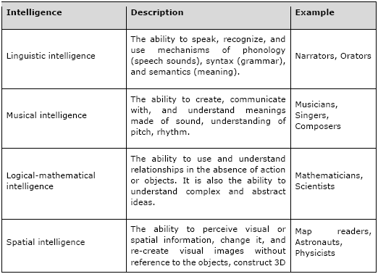
Types of Intelligence

Slide 7
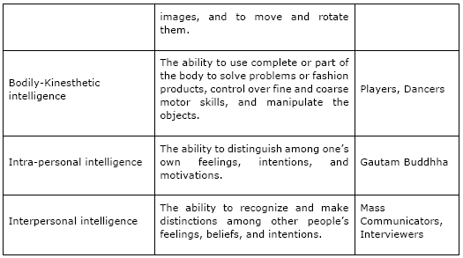
Types of Intelligence - 2

Slide 8
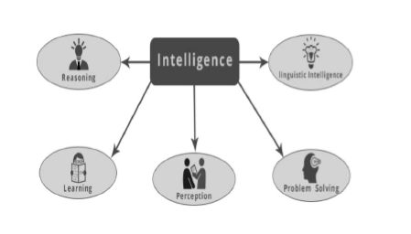
What is Intelligence Composed Of?

Slide 9
Reasoning
It is the set of processes that enable us to provide basis for judgement, making decisions, and prediction. There are broadly two types −

Slide 10
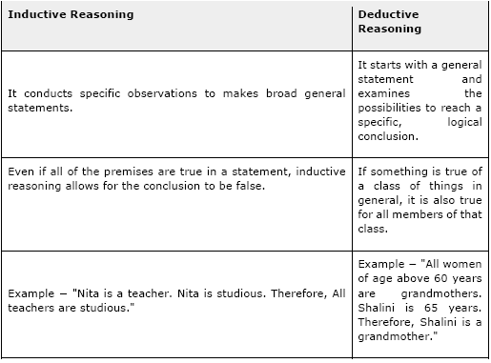
Two types of reasoning

Slide 11
Learning
The ability of learning is possessed by humans, particular species of animals, and AI-enabled systems. Learning is categorized as follows −
Auditory Learning
It is learning by listening and hearing. For example, students listening to recorded audio lectures.
Episodic Learning
To learn by remembering sequences of events that one has witnessed or experienced. This is linear and orderly.
Motor Learning
It is learning by precise movement of muscles. For example, picking objects, writing, etc.

Slide 12
Learning - 2
Observational Learning
To learn by watching and imitating others. For example, child tries to learn by mimicking her parent.
Perceptual Learning
It is learning to recognize stimuli that one has seen before. For example, identifying and classifying objects and situations.
Relational Learning
It involves learning to differentiate among various stimuli on the basis of relational properties, rather than absolute properties. For Example, Adding ‘little less’ salt at the time of cooking potatoes that came up salty last time, when cooked with adding say a tablespoon of salt.
Spatial Learning
It is learning through visual stimuli such as images, colors, maps, etc. For example, A person can create roadmap in mind before actually following the road.
Stimulus-Response Learning
It is learning to perform a particular behavior when a certain stimulus is present. For example, a dog raises its ear on hearing doorbell.

Slide 13
Problem Solving
It is the process in which one perceives and tries to arrive at a desired solution from a present situation by taking some path, which is blocked by known or unknown hurdles.
Problem solving also includes decision making, which is the process of selecting the best suitable alternative out of multiple alternatives to reach the desired goal.

Slide 14
Perception
It is the process of acquiring, interpreting, selecting, and organizing sensory information.
Perception presumes sensing. In humans, perception is aided by sensory organs. In the domain of AI, perception mechanism puts the data acquired by the sensors together in a meaningful manner.

Slide 15
Linguistic Intelligence
It is one’s ability to use, comprehend, speak, and write the verbal and written language. It is important in interpersonal communication.

Slide 16
What’s Involved in AI
Machine Learning
It is one of the most popular fields of AI. The basic concept of this filed is to make the machine learning from data as the human beings can learn from his/her experience. It contains learning models on the basis of which the predictions can be made on unknown data.
Logic
It is another important field of study in which mathematical logic is used to execute the computer programs. It contains rules and facts to perform pattern matching, semantic analysis, etc.
Searching
This field of study is basically used in games like chess, tic-tac-toe. Search algorithms give the optimal solution after searching the whole search space.
Artificial neural networks
This is a network of efficient computing systems the central theme of which is borrowed from the analogy of biological neural networks. ANN can be used in robotics, speech recognition, speech processing, etc.

Slide 17
What’s Involved in AI - 2
Genetic Algorithm
Genetic algorithms help in solving problems with the assistance of more than one program. The result would be based on selecting the fittest.
Knowledge Representation
It is the field of study with the help of which we can represent the facts in a way the machine that is understandable to the machine. The more efficiently knowledge is represented; the more system would be intelligent.

Slide 18
Application of AI
Gaming
AI plays crucial role in strategic games such as chess, poker, tic-tac-toe, etc., where machine can think of large number of possible positions based on heuristic knowledge.
Natural Language Processing
It is possible to interact with the computer that understands natural language spoken by humans.
Expert Systems
There are some applications which integrate machine, software, and special information to impart reasoning and advising. They provide explanation and advice to the users.
Vision Systems
These systems understand, interpret, and comprehend visual input on the computer. For example,
• A spying aeroplane takes photographs, which are used to figure out spatial information or map of the areas.
• Doctors use clinical expert system to diagnose the patient.
• Police use computer software that can recognize the face of criminal with the stored portrait made by forensic artist.

Slide 19
Application of AI - 2
Speech Recognition
Some intelligent systems are capable of hearing and comprehending the language in terms of sentences and their meanings while a human talks to it. It can handle different accents, slang words, noise in the background, change in human’s noise due to cold, etc.
Handwriting Recognition
The handwriting recognition software reads the text written on paper by a pen or on screen by a stylus. It can recognize the shapes of the letters and convert it into editable text.
Intelligent Robots
Robots are able to perform the tasks given by a human. They have sensors to detect physical data from the real world such as light, heat, temperature, movement, sound, bump, and pressure. They have efficient processors, multiple sensors and huge memory, to exhibit intelligence. In addition, they are capable of learning from their mistakes and they can adapt to the new environment.

Slide 20
Agent & Environment
Agent
An agent is anything that can perceive its environment through sensors and acts upon that environment through effectors.
• A human agent has sensory organs such as eyes, ears, nose, tongue and skin parallel to the sensors, and other organs such as hands, legs, mouth, for effectors.
• A robotic agent replaces cameras and infrared range finders for the sensors, and various motors and actuators for effectors.
• A software agent has encoded bit strings as its programs and actions.

Slide 21
Agent & Environment - 2
Environment
Some programs operate in an entirely artificial environment confined to keyboard input, database, computer file systems and character output on a screen.
In contrast, some software agents (software robots or softbots) exist in rich, unlimited softbots domains. The simulator has a very detailed, complex environment. The software agent needs to choose from a long array of actions in real time. A softbot is designed to scan the online preferences of the customer and shows interesting items to the customer works in the real as well as an artificial environment.

